Slide 1

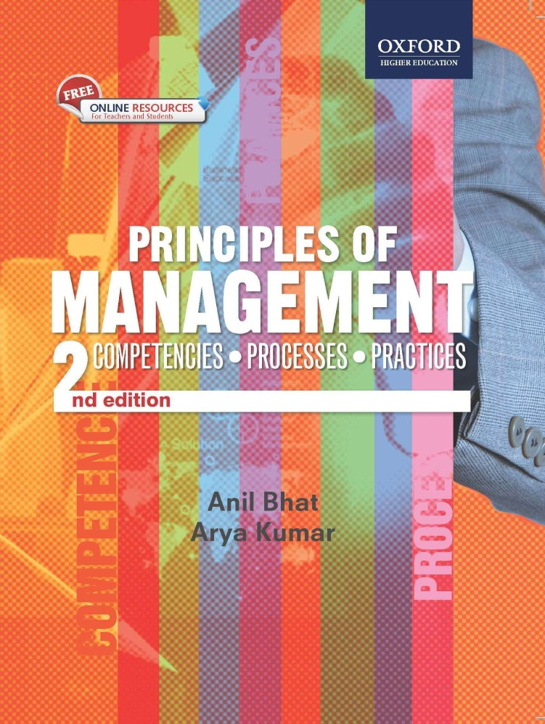
Principles of
Management ,2e
Anil Bhat
Arya Kumar

Slide 2
PLANNING – A TOOL FOR EFFECTIVE MANAGEMENT

Slide 3
Learning Objectives
  To understand the importance of planning
  To know what plan and planning mean
  To learn about steps involved in planning
  To learn about different types and levels of planning
  To understand SWOT analysis as a tool for business strategies development
  To understand the use of BCG matrix in categorization of businesses
  To understand concept of MBO and its relevance to planning

Slide 4
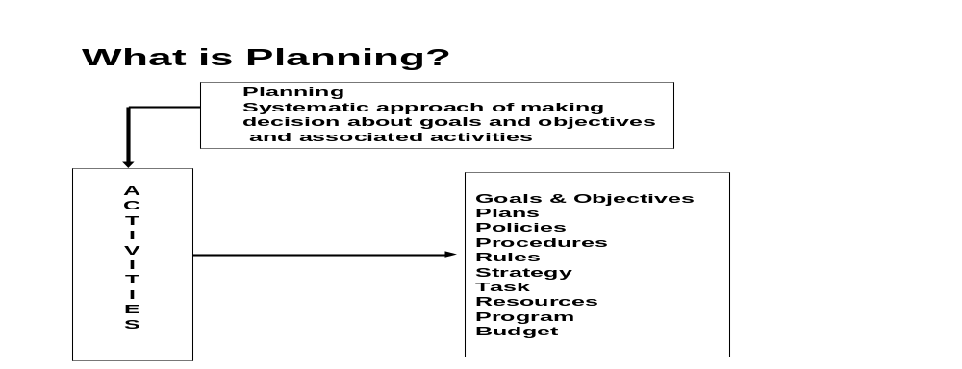
Planning and its Various Facets
Planning refers to a systematic approach towards making decisions about goals and objectives and the associated activities that need to be carried out along with various resource requirements.

Slide 5
Goals and Objectives
Goals refer to specific objectives that an organization aspires to accomplish in total, or in some combination, in order to achieve some larger purpose, i.e., the mission of an organization.
Objectives are clear and verifiable yardsticks against which performance can be measured. The accomplishment of various functional and departmental objectives lead to the achievement of goals.

Slide 6
Plans and Policies
Plans are the actions or means that a manager proposes to use for achieving pre- determined goals. A plan indicates what the management wants to achieve. It specifies the steps that are to be taken towards the achievement of goals.
Policies refer to a broad statement and/or a set of guidelines that direct decision-making. It is a plan of action adopted by an individual or an organization. They define the framework within which managers are expected to make decisions leading to the achievement of objectives.

Slide 7
Procedures, Rules and Strategies
Procedures are plans that set out the required methods and processes to handle future activities.
Rules refer to principles or conditions that govern behavior. They define specific required actions and inactions in given circumstances .
Strategies are an elaborate and systematic plan of action. These are the methods or processes required in total, or in some combination, to achieve the goals.

Slide 8
Objectives and Tasks
Objectives are specific targets that must be accomplished in total, or in some combination so as to achieve the predetermined goals in the plan.
A piece of work that is undertaken to contribute towards the achievement of objectives is called ‘task’.

Slide 9
Resources, Programmes , and Budget
Resources include the people, materials, machines, technologies, money, etc. required to implement the strategies or processes.
A program is a combination of goals, policies, procedures, rules, and set of activities to be undertaken, resources to be deployed and other interrelated actions required to be undertaken for accomplishment of a purpose.
Budget is a statement of expected provisions or results expressed in numerical terms. It can be for inputs as well as outputs.

Slide 10
Definitions:
“Generally speaking, planning is deciding in advance what is to be done” -W H Newman
“Planning is deciding in advance what to do, how to do, when to do and who is to do it. Planning bridges a gap between from where we are to where we want to go”
-Harold, Koontz and O’Donnel
“Planning is that function of manner in which he decides in advance what he will do. It is a decision making process of a special kind, its essence is futurity.”
-Hayness and Massie

Slide 11
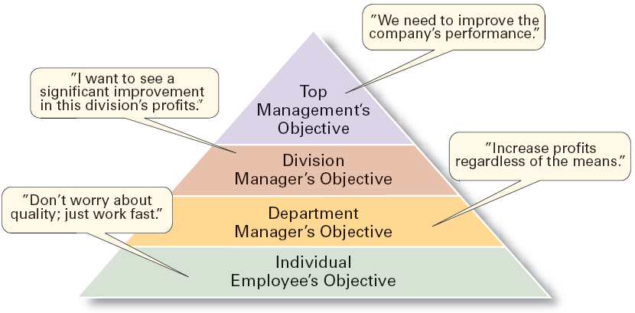
The Downside of Traditional Goal Setting

Slide 12
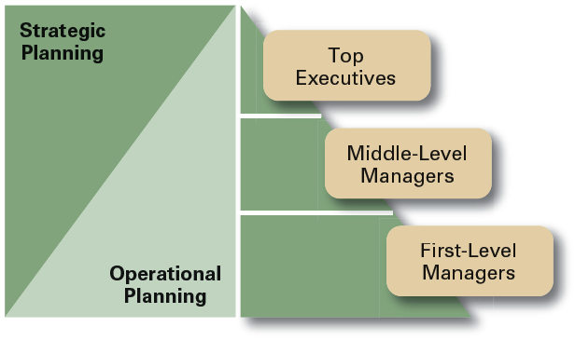
Planning in the Hierarchy of Organizations

Slide 13
Contemporary Issues in Planning
Criticisms of Planning
  Planning may create rigidity.
  Plans cannot be developed for dynamic environments.
  Formal plans cannot replace intuition and creativity.
  Planning focuses managers’ attention on today’s competition not tomorrow’s survival.
  Formal planning reinforces today’s success, which may lead to tomorrow’s failure.

Slide 14
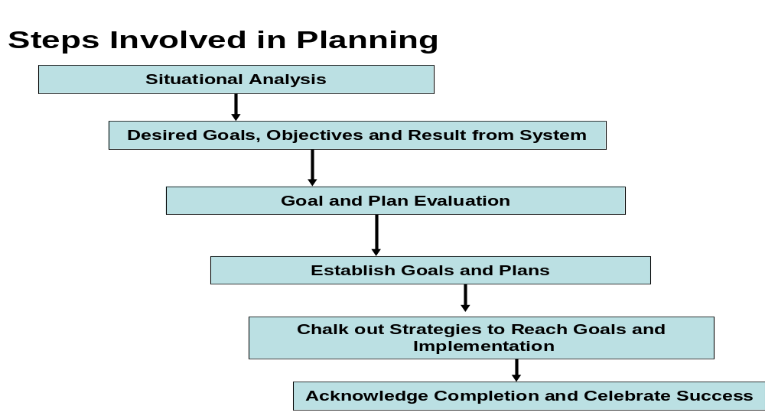

Slide 15
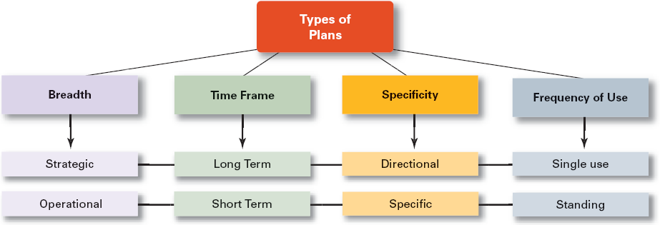
Types of Plans

Slide 16
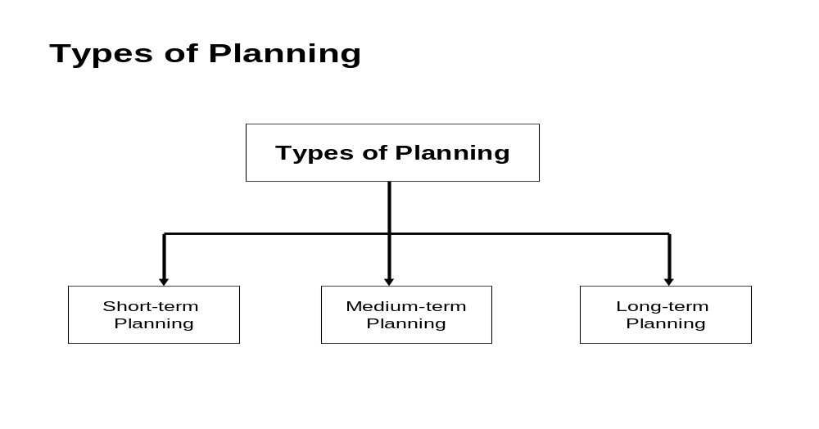
Management: Principles, Processes & Practices
© Oxford University Press 2008 All rights reserved

Slide 17
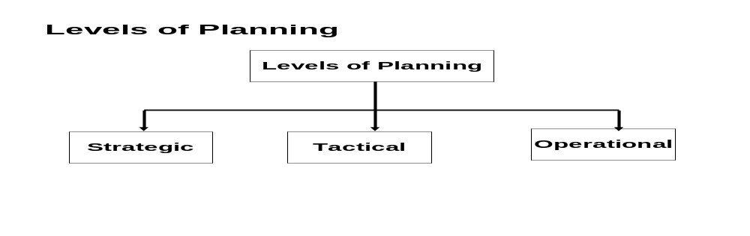
Strategic planning is undertaken at the top-level of the management. It deals with decision making about the organization’s long-term goals and strategies .
Tactical planning deals primarily with the specific goals and plans pertaining to functional areas – production, marketing, human resources management, etc. It deals with major actions pertaining to implementation phase of the planning process.
Operational planning deals with specific systems, procedures, and processes required to implement the tactical plan at the level of the operational or frontline manager.

Slide 18
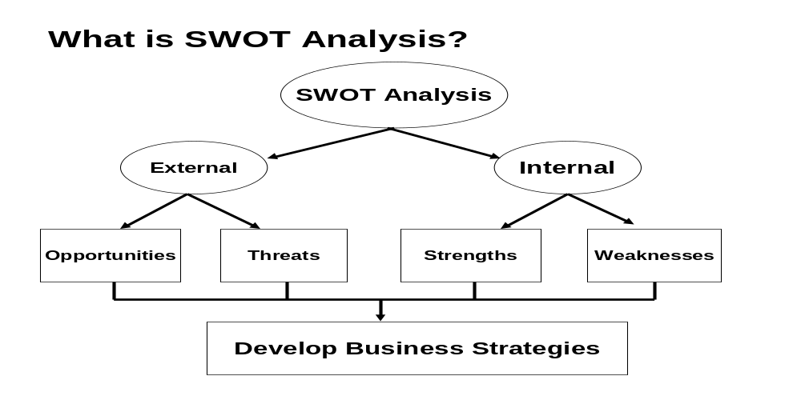
Opportunities and threats are diagnosed by undertaking an external environmental analysis.
Strengths and weaknesses are essentially internal to the organization and
pertain to its resources. These relate to resources – human and non-human, physical, processes, programs, and organization in key areas.

Slide 19
Developing Business Strategy
SWOT analysis helps in identification of possible strategies based on the following criteria:
Build and develop on strengths
Resolve and overcome weaknesses
Exploit and avail opportunities
Avoid or minimize the effect of threats
BCG (Boston Consulting Group) has developed a tool that enables the mapping of all the organization’s businesses based on the criteria of market growth and relative competitive position vis-à-vis competitors.

Slide 20
BCG Matrix—A Tool for Mapping Businesses of Organization
Market Growth
STARS QUESTION
MARKS
CASH COWS DOGS
Relative Competitive Position
Stars are the businesses having high growth as well as a strong competitive position.
Dogs have low growth and weak-competitive position businesses.
Cash Cow businesses have low growth but are having strong competitive position .
Question Marks are the businesses that have high growth but weak competitive position

Slide 21
Management By Objectives (MBO) MBO is a management system that is goal driven and success-oriented
MBO is defined as an integrated managerial system that is systematically and consciously directed towards achievement of organizational and individual objectives
Employees Get Adequate and Strong Input to be Clear about their Objectives, Time Lines for Completion
Synchronizing Goals and Subordinate objectives throughout the Organization
Tracks Performance to Provide a Feedback for Taking Timely Corrective Measures
Enhances Organizational Performance

Slide 22
Salient Features of MBO
Cascading of Organizational Goals and Objectives
Specific Objectives Driven
Salient Features of MBO
Participative Decision Making Process
Explicit Time Period Deadlines
Performance Evaluation and
Feedback

Slide 23
Benefits of MBO
Ensuring personal commitment to organizational goals
Provides goal and role clarity in the organization and in turn helps in devising organizational structure conducive for improving efficiency and effectiveness
Ensures result oriented planning
Development of effective control mechanism leading to timely corrective actions
Less supervision of subordinates and increased motivational level as a result of each employees clear definition of responsibilities
Employees accountability increases
Improved managerial effectiveness and efficiency results in greater satisfaction level to the employees

Slide 24
Disadvantages of MBO
Failure to teach the philosophy of MBO across the organization
Lack of guidelines to goal setters
Difficulty in setting verifiable objectives
Over emphasis on short term achievements at the cost of long term growth and development
Lack of flexibility to attune changes with changing environmental forces
Over emphasis on quantitative goals, even where it may not be applicable
It turns out to be paper passing buck, especially in organizations where in well set mechanism to monitor and evaluate the performance does get laid down
It is a time consuming process to imbibe the philosophy of MBO in the organization

Slide 25
THANK YOU

